Slide 1


SmartTrack: Satellite Security Analysis with SQL

Slide 2
ABSTRACT
SmartTrack is a SQL-based Satellite Security analysis project focused on monitoring and securing satellite systems. Using structured datasets imported into MySQL Workbench, the project simulates a space infrastructure where telemetry data, RF signals, access logs, user profiles, satellite metadata and anomaly reports are analyzed to detect threats. Key cybersecurity issues such as signal jamming, telemetry spoofing, and unauthorized access are explored through SQL queries. The database schema is designed around six interconnected tables, enabling real-time analysis of suspicious patterns across multiple data sources. This project demonstrates the use of relational databases in a cybersecurity context, applying SQL to detect anomalies, audit user behavior, and investigate potential attacks on satellite networks. SmartTrack highlights practical skills in data modeling, threat analysis, and SQL-driven reporting all essential for a data analyst working in modern security-focused environments.

Slide 3
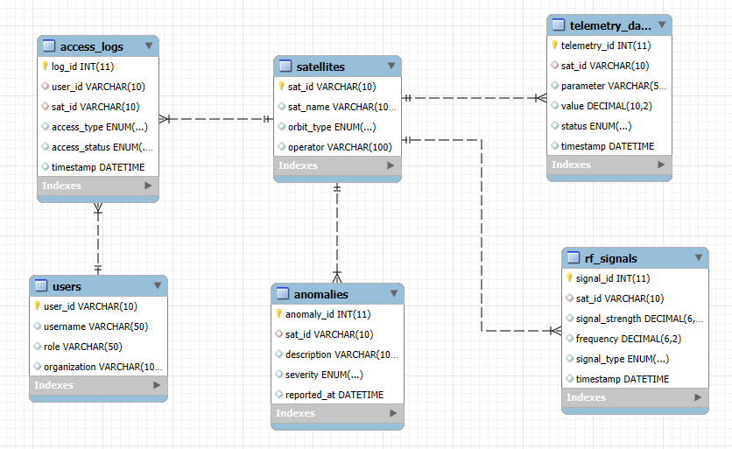
ER DIAGRAM

Slide 4
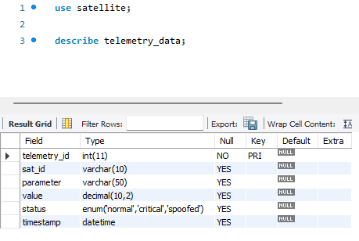
STRUCTURE OF TABLE
Database Table Structure for Telemetry Data in Satellite System
The image shows the structure of the telemetry_data table in the satellite database. It has six fields: telemetry_id (primary key), sat_id, parameter, value, status, and timestamp. The value field stores decimal readings, and status can be normal, critical, or spoofed. The timestamp field logs when the data was recorded. This structure helps store and monitor satellite telemetry efficiently.

Slide 5
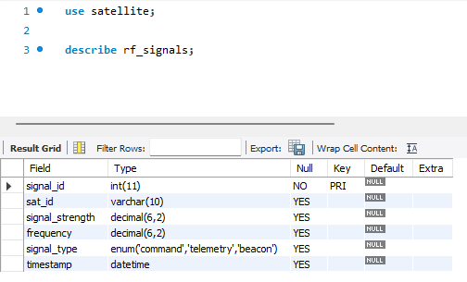
The image shows the structure of the rf_signals table in the satellite database. It has six fields: signal_id (primary key), sat_id, signal_strength, frequency, signal_type, and timestamp. The signal_strength and frequency fields store decimal values, while signal_type can be command, telemetry, or beacon.
STRUCTURE OF TABLE
Database Table Structure for Radio Frequency Signals Data in Satellite System
Dkfdkn

Slide 6
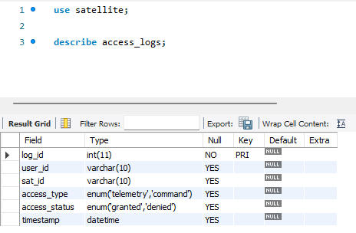
The access_logs table records user interactions with satellites, including user ID, satellite ID, access type, status, and timestamp. It helps monitor authorized and unauthorized access, enabling quick detection of suspicious activity.
STRUCTURE OF TABLE
Database Table Structure for Access Logs in Satellite System

Slide 7
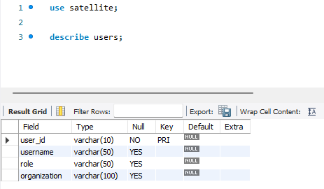
The users table stores information about system users, including user ID, username, role, and organization. It supports access control and links user activities to specific individuals for security auditing.
STRUCTURE OF TABLE
Database Table Structure for Users in Satellite System

Slide 8
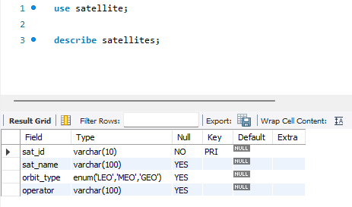
The satellites table contains details of each satellite, including satellite ID, name, orbit type, and operator. It links operational data, signals, and anomalies to specific spacecraft for monitoring and analysis.
STRUCTURE OF TABLE
Database Table Structure for Satellites in Satellite System

Slide 9
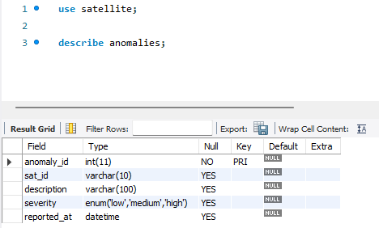
The anomalies table records unusual satellite events, including anomaly ID, satellite ID, description, severity, and report time. It helps identify and analyze critical issues affecting satellite performance and security.
STRUCTURE OF TABLE
Database Table Structure for Anomaliesin Satellite System

Slide 10
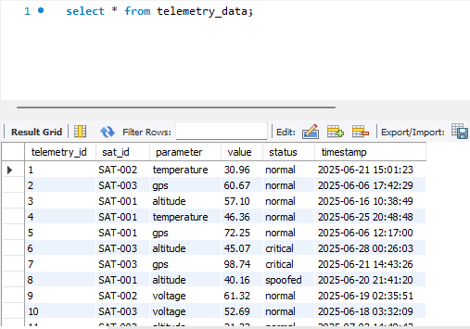
CONTENT OF TABLE
Table : Telemetry Data

Slide 11
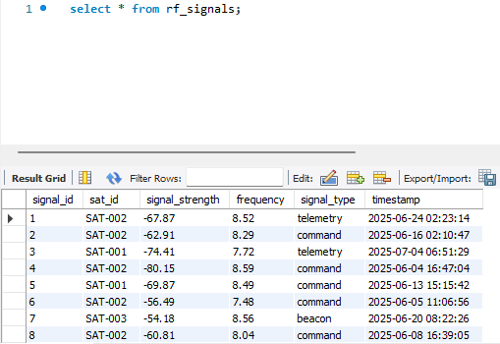
CONTENT OF TABLE
Table : Radio Frequency Signals

Slide 12
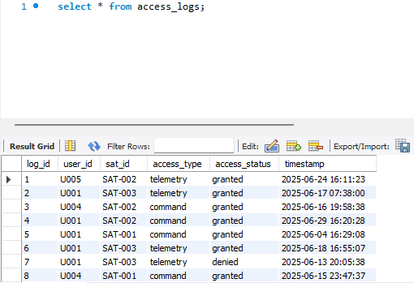
CONTENT OF TABLE
Table : Access Logs

Slide 13
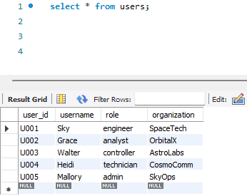
CONTENT OF TABLE
Table : Users

Slide 14
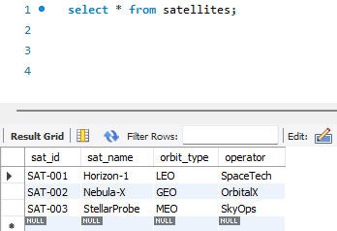
CONTENT OF TABLE
Table : Satellites

Slide 15
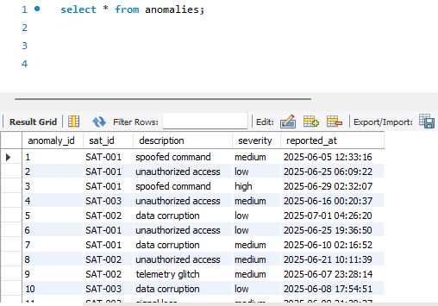
CONTENT OF TABLE
Table : Anomalies

Slide 16

JOINS
A JOIN is used to combine rows from two or more tables based on a related column. In the SmartTrack project, joins help connect satellite data, telemetry, access logs, users, and anomalies to get meaningful insights. The main types of joins used here are:
INNER JOIN → returns only matching records between tables.
LEFT JOIN → returns all records from the left table and matching ones from the right (null if no match).
RIGHT JOIN → similar to LEFT JOIN but returns all from the right table.

Slide 17
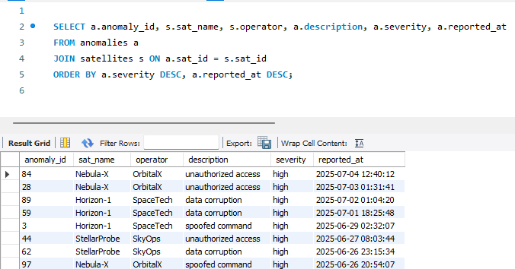
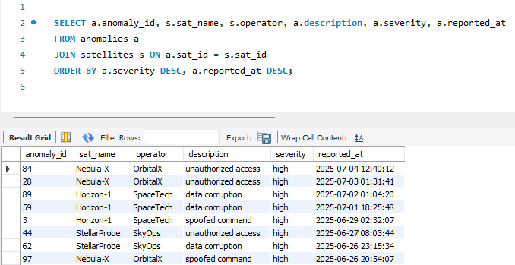
QUERY 1 — ANOMALIES WITH SATELLITE INFO, SORTED BY SEVERITY.
This query uses an INNER JOIN to connect ‘anomalies’ with ‘satellites’ based on ‘sat_id’.
It returns each anomaly along with the satellite’s name and operator. Results are sorted so the most severe and latest issues appear first.

Slide 18
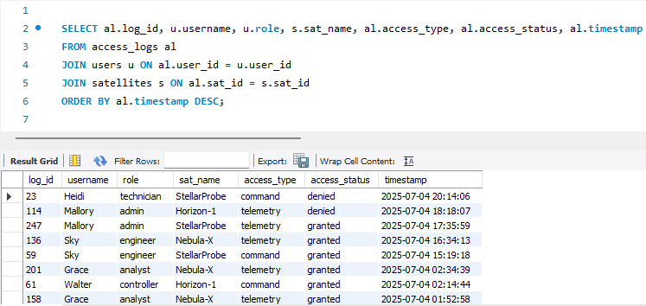
QUERY 2 — ATTEMPTS ACCESS WITH SATELLITE AND USER INFO.
This query joins three tables: access_logs, users and satellites.
It shows who accessed which satellite, the type of access, whether it was successful, and when it occurred — ordered with the latest activity first.

Slide 19
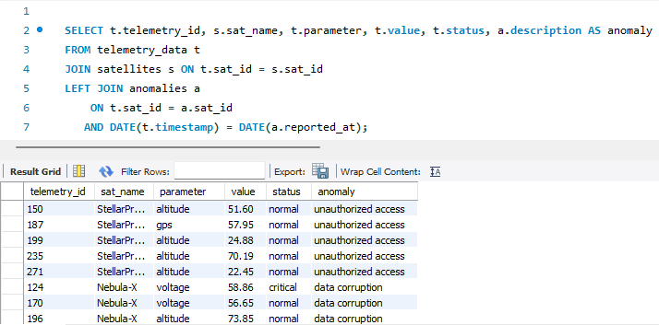
QUERY 3 — TELEMETRY WITH ANOMALIES REPORTED THE SAME DAY.
Here we use a LEFT JOIN so all telemetry records are shown, even if there is no anomaly on that day. If there is a match in anomalies for the same satellite and date, its description is shown.

Slide 20

WINDOW FUNCTIONS
Window functions perform calculations across a set of rows that are related to the current row, without collapsing them into a single result like GROUP BY would.
They are written with an OVER() clause, which defines the "window" of rows for calculation. Common types used here:
RANK() → Assigns rank to rows based on a sort order.
AVG() OVER(PARTITION BY) → Calculates average within a group without reducing rows.
ROW_NUMBER() → Assigns a unique sequential number to rows within a group.

Slide 21
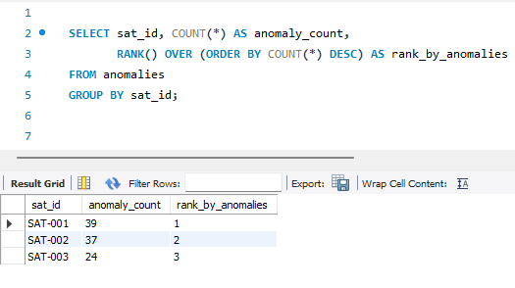
QUERY 1 — RANKING SATELLITES BY ANOMALY COUNT.
This uses the RANK() window function to rank satellites based on the number of anomalies. Satellites with the same count get the same rank.

Slide 22
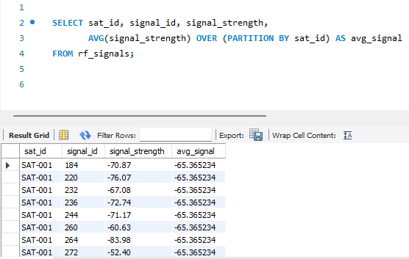
QUERY 2 — COMPARE EACH SIGNAL TO SATELLITE’S AVERAGE.
AVG() OVER (PARTITION BY) calculates the average signal strength for each satellite without grouping the rows, allowing us to compare each reading to the average.

Slide 23
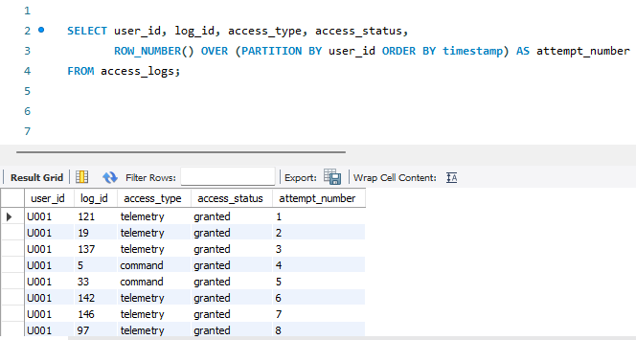
QUERY 3 — NUMBER EACH USER’S ACCESS ATTEMPTS IN ORDER.
The ROW_NUMBER() function gives a sequence number to each access attempt per user, ordered by time.

Slide 24

VIEWS
A VIEW is a stored query that acts like a virtual table.
They don’t store the data physically (unless materialized), but store the SQL query definition.
Simplifies repeated queries, improves readability, and adds a layer of security (hide complex joins from end users).

Slide 25
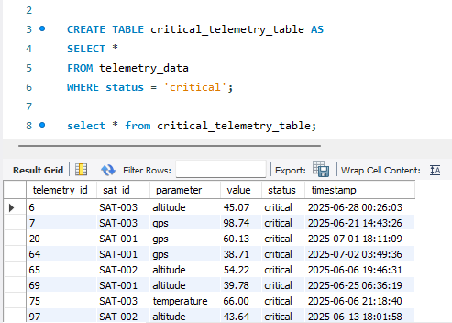
QUERY 1 — TELEMETRY DUPLICATES.
Creates a saved view showing only telemetry records marked as “critical”. This makes it easy to query only urgent cases.

Slide 26
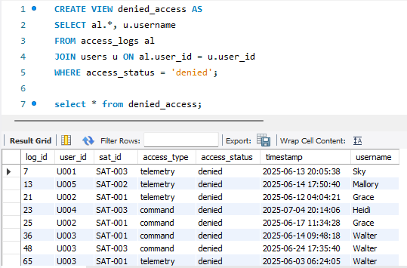
QUERY 2 — DENIED ACCESS ATTEMPTS WITH USERNAMES.
Stores a view of all denied access attempts, including which user made them.

Slide 27
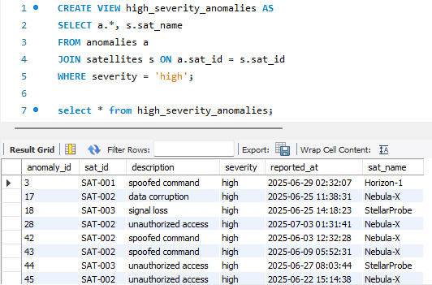
QUERY 3 — HIGH SEVERITY ANOMALIES WITH SATELLITE NAMES.
A ready-to-use view for listing all high-severity anomalies along with the satellite name.

Slide 28

SUBQUERIES
A Subquery is a query inside another query.
It is often used to filter results based on another query.
It compares against the aggregated values and check for existence of data.

Slide 29
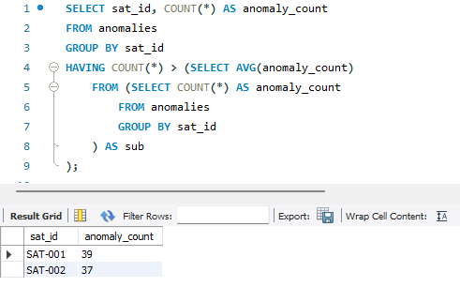
QUERY 1 — SATELLITES WITH ABOVE AVERAGE ANOMALIES.
The inner subquery calculates the average anomalies per satellite. The outer query returns only those satellites exceeding this average.

Slide 30
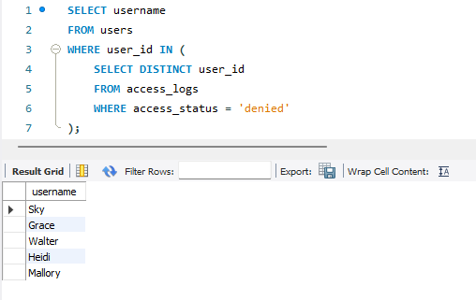
QUERY 2 — USER WITH DENIED ACCESS.
Finds all usernames that appear in the access logs with at least one denied attempt.

Slide 31
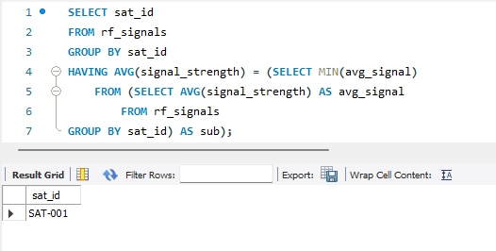
QUERY 3 — SATELLITES WITH LOWEST AVERAGE SIGNAL STRENGTH.
Compares average signal strength of satellites and returns those with the minimum average.

Slide 32



KEY CYBERSECURITY CHALLENGES
SmartTrack directly confronts prevalent threats to satellite systems, enabling
proactive detection and response.
Signal Anomalies
Telemetry Spoofing
Unauthorized Access Tracking
Detection of unusual RF signal strength or frequency patterns that may indicate interference or jamming attempts.
Identification of telemetry parameters crossing critical thresholds to detect potential system failures or spoofing.
Analysis of user access logs to spot repeated failed login attempts, privilege misuse, or unusual access times.

Slide 33

CONCLUSION
The SmartTrack project successfully demonstrates how SQL can be applied to monitor and secure satellite systems by integrating telemetry data, RF signals, access logs, anomaly reports, and user information into a unified relational database. Using MySQL Workbench, the project showcases advanced querying techniques including joins, window functions, subqueries, and views to detect anomalies, analyze suspicious activity, and identify potential security threats such as signal jamming, telemetry spoofing, and unauthorized access. This end-to-end database design and analysis highlights the effectiveness of SQL as a powerful tool for cybersecurity threat detection in critical space infrastructure, while also building practical skills essential for data analysts in security-focused domains.
For more information or to discuss collaboration opportunities, please contact us.

